Slide 1
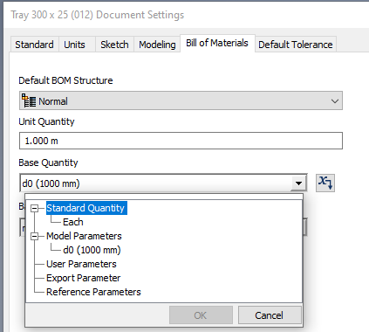
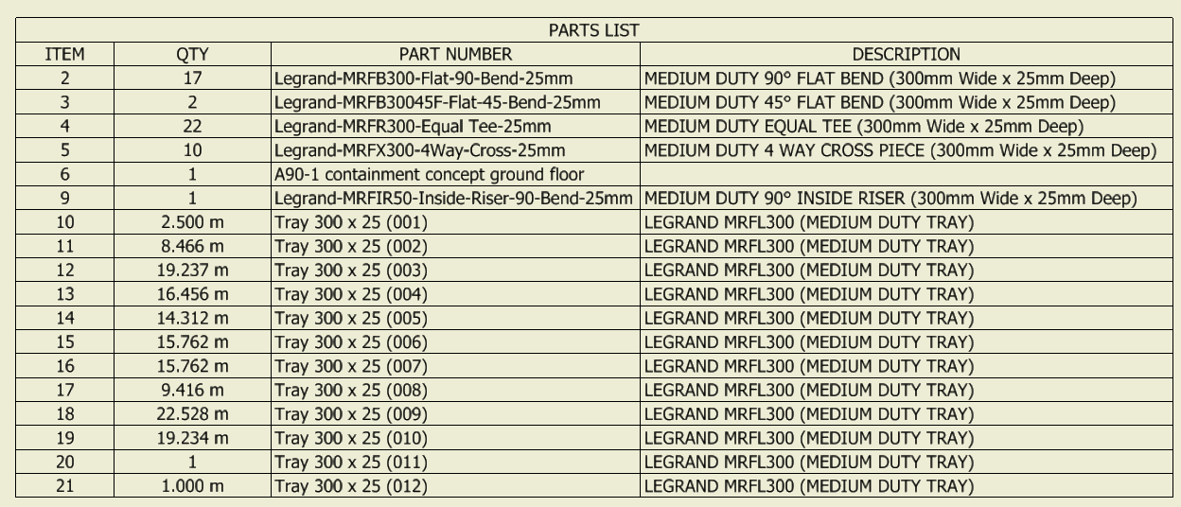
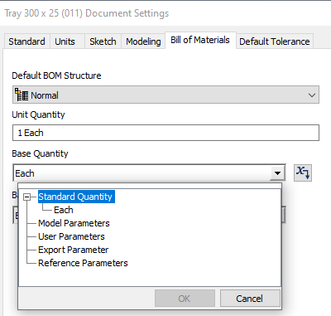
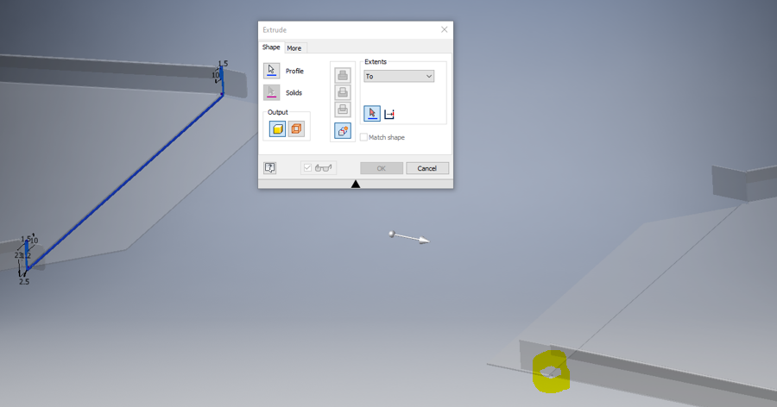
My aim is to have a bom on the drawing that identifies the combined length of the trunking that’s used. As shown on the left. All the dimensions for items 10 – 21 have been extruded to their distances (the bill of material on each part has the parameter selected as shown. 20 however has been extruded to a point as shown below.
Bill of Material parameter for item 21 where the extrusion is to a distance.
A new component has been created in the assembly and a sketch created on a plane of an existing component, the sketch is then extruded to the highlighted point on the next component. This doesn’t give a length, just a quantity within the bom.
Bill of Material parameters for item 20 where the extrusion is to a point. There isn’t any parameters.

Slide 2
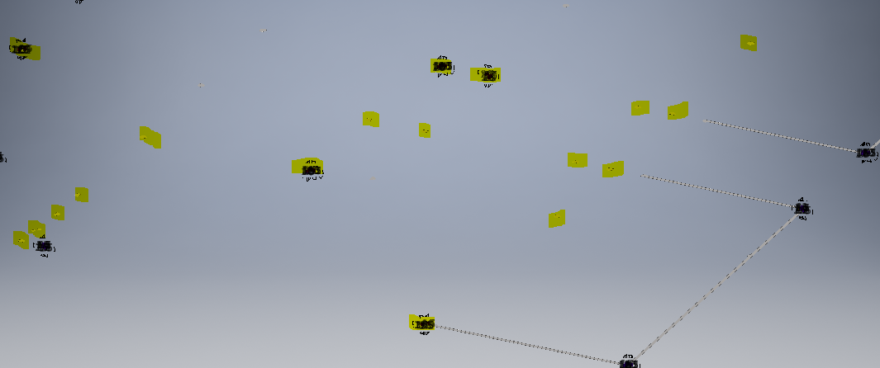
Extrusion will be created between each of the highlighted constrained components, and we’d like an overall length of all the tray (extrusions)

